Slide 1
Town Hall and Informational Session New Beginnings, New Heights of The Islamic School of San Diego
April 27th 2018

Slide 2
Our Vision…
… be “the” best Islamic School in US, #1
We have the will, finances and resources to make it happen, in’sha’Allah !
How exactly?!
1. Financial stability
2. Great facility
3. Best administration
4. Best teachers and curriculum
5. Best student body

Slide 3
New ISSD
As you may know we bought a new 4.5 acre campus in Allied Gardens, Alhamdulillah
Currently rented to Excelsior Academy. Their rental contract expires this Summer
Excelsior has found a new facility and will hand over the possession to us on July 7th, in’sha'Allah
So with the grace of Allah SWT, we will start our Allied Gardens campus this Fall, in’sha'Allah

Slide 4
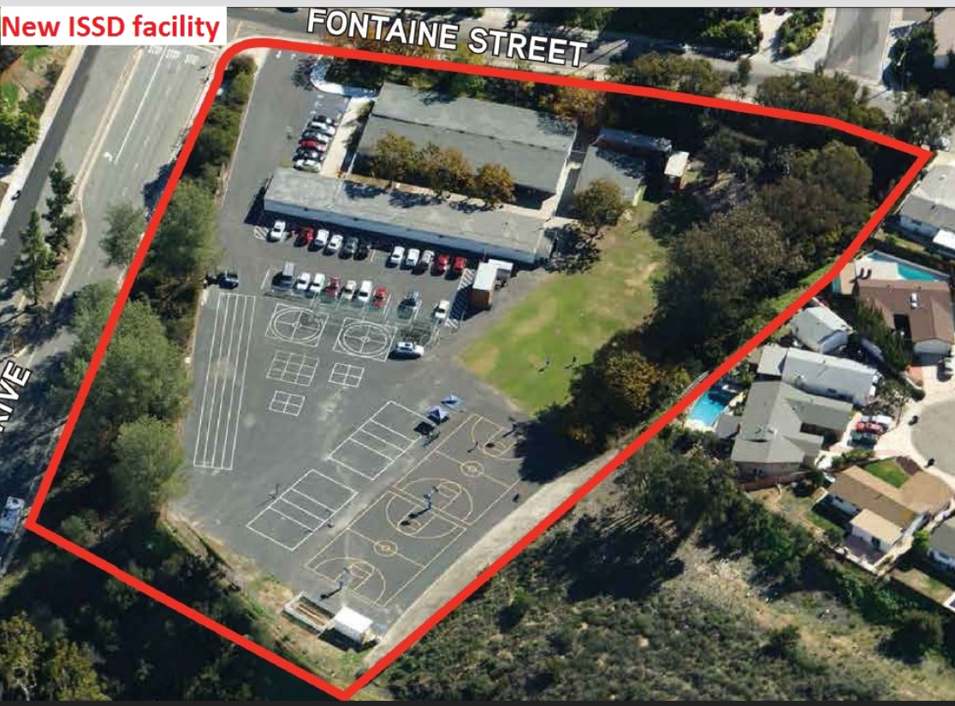

Slide 5
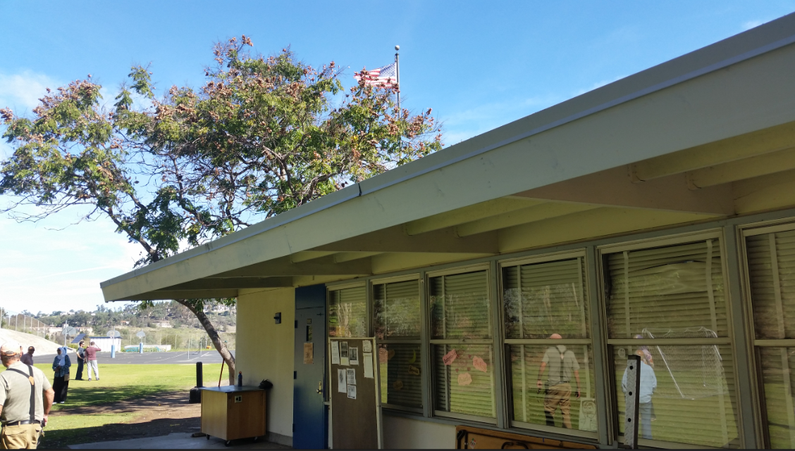
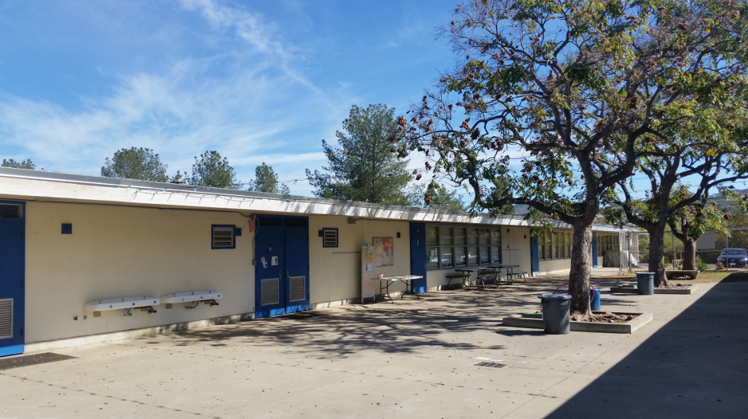
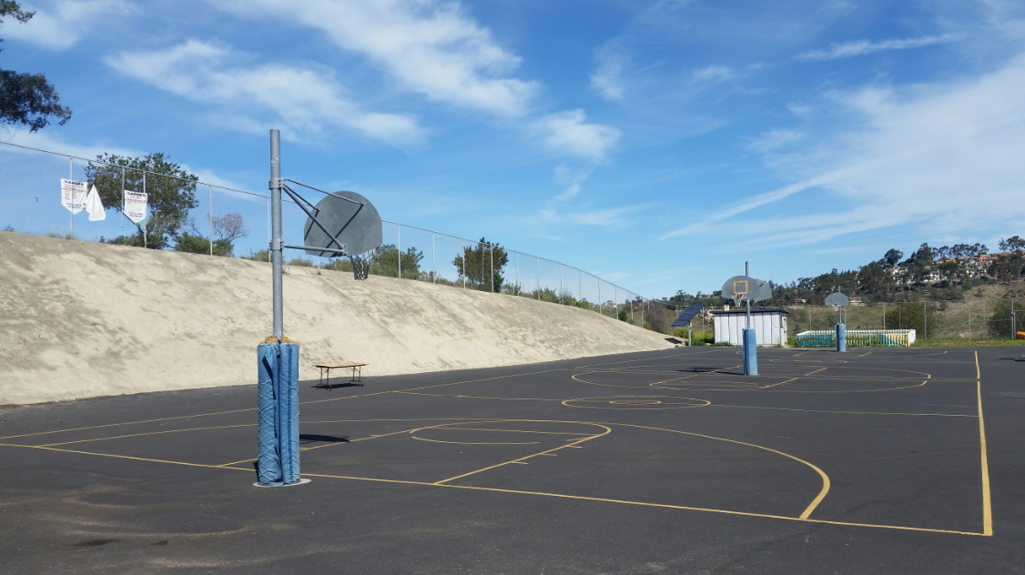
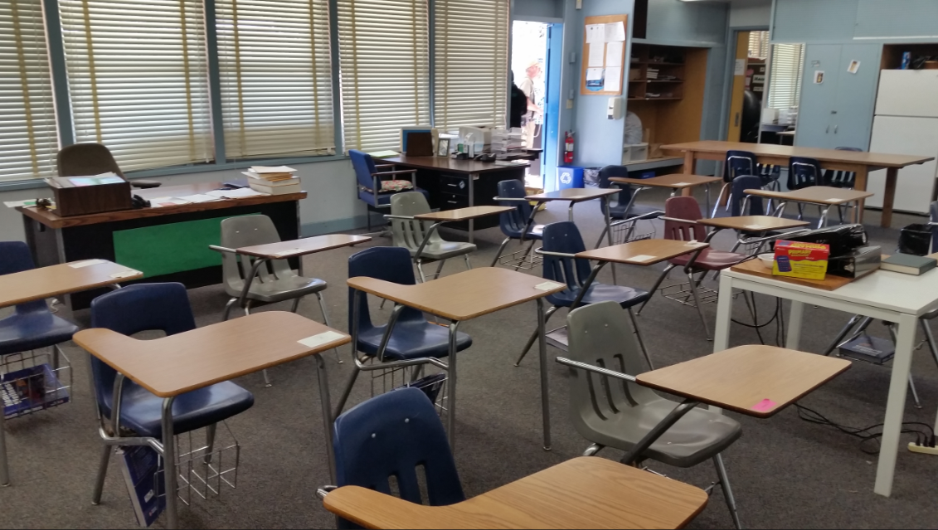

Slide 6
New ISSD (cont’d)
We will run both campuses with total of 17 classrooms and ~400 students capacity
TK-5th in Clairemont
6th to 7th, parallel TK, parallel KG and new 9th grade in Allied Gardens
Timings: Clairemont: 8AM to 3:30PM (12:30PM Fri), Allied Gardens: 8:15AM to 3:15PM
Bus transportation provided for middle and high school kids
Leaving Clairemont at 7:45AM, arrive at Allied Gardens at 8:10AM
Leaving Allied Gardens at 3:20PM, arrive at Clairemont by 3:40PM
Possibility of providing bus service from-to MCC if there is enough interest
We now have a new name for the school, “Bright Horizon Academy”
http://brighthorizonacademcy.org
http://brighthorizon.academcy

Slide 7
We have the finances to make it happen!
We have had a balanced budget for last 7+ years, breaking even with just tuition, using fundraisers purely for expansion
Adding new facility expenses and mortgage, we know our P&L will be in the red for first couple of years
Have been making minimum mortgage payments, setting aside money in anticipation for this time
We have a healthy bank balance to weather initial 2 to 3 years of negative cash flow
Have a goal and plan to increase enrollment and break even in 3 years with a balanced budget again, in’sha’Allah
After 3 years we will refocus on paying off the mortgage, in’sha’Allah
We Hired Top Management Team → Dream Team

Slide 8
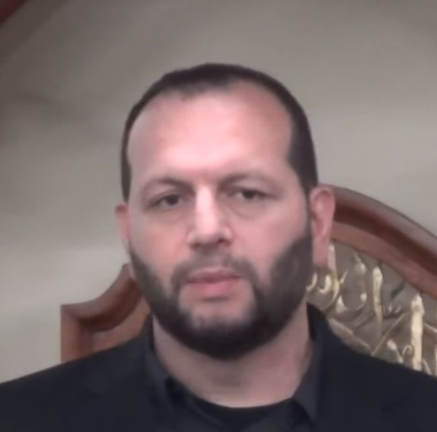
New Principal: Mohammad Aftab Diwan
Currently superintendent of “Islamic School of Irving”, one of the best Islamic Schools in the
U.S., a 650 student strong K-12 school.
Credentials:
Bachelors Degree in Elementary Education from Cal State Northridge
Teaching credential coursework along with a Masters in Education from Pepperdine University
Has been in the field of education and youth counseling for the past 25 years
Taught various grades at the elementary levels in the Los Angeles area including Quran and Islamic Studies before moving to Dallas in 2005
Moved to Dallas in 2005
For the past 13 years he has served in a variety of administrative roles initially as a Vice Principal and then Principal and currently Superintendent for the last 9 years
Acquired further training from the Love and Logic Institute in Denver Colorado as an instructor in teaching, parenting, and behavior management
Served on the committee for the ISNA National Educational Forum for more than 5 years. Has presented workshops, seminars, and lectures at local and national events
Married with two kids aged 15 and 12

Slide 9
New Director of Education
Highly qualified, professional educator
25 + years of experience; various educational settings
Masters Degree + specialized training
California Credentials (multiple subject and single subjects)
Experience with WASC Accreditation Process
Committed to education for the local Muslim community

Slide 10
High School Program Highlights
Main focus on preparing our students for top Universities in California and US
Very experienced, credentialed teachers
Hired Sr. Ayesha Boulil, a very experienced High School English teacher
Math and Science teachers to be announced soon, IA
WASC, UCSD and SDSU accreditation
STEM Internships in partnership with SDSU
Preparation for SAT and ACT
Special one time Tuition Discount of $1000 for the first year
All other goodies like Security, Hot lunch, after school program, etc
Jumma Salah for students, parents and staff

Slide 11
Islamic High School Appeal !
Muslim identity, staff, students and environment
Top academic program to prepare for best colleges in California and US
Familiar, close friends and teachers
Impressive sports and academic extra-curricular activities for both girls and boys
National as well as Islamic holidays for Eid, Hajj, etc.
Opportunity for our future leaders and scholars to lead Jumma Khutbah and Salah

Slide 12
Important Dates
April 23rd - General registration started
June 7th - Last day of 2017-18 school year
April 2nd – May 31st – Online financial aid applications accepted
June 29th – Parents notified of financial aid status
Sep 4th – First day of school for 2018-19 school year

Slide 13
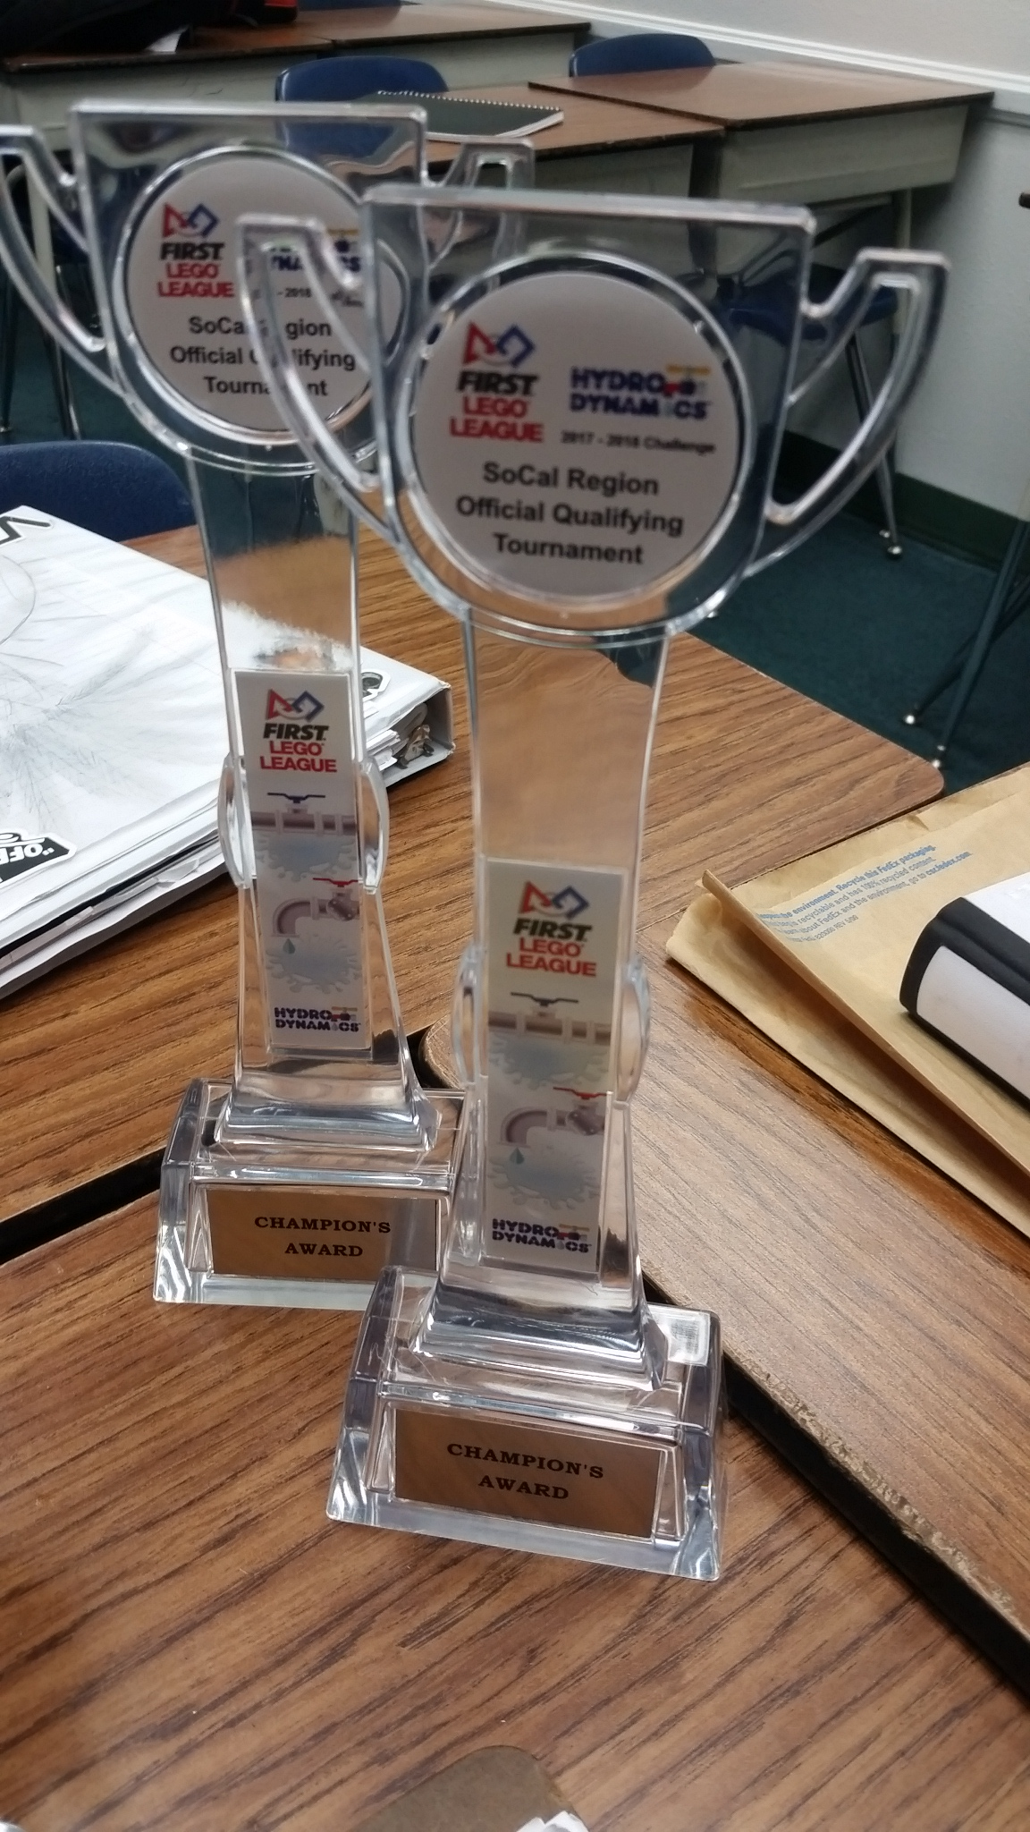
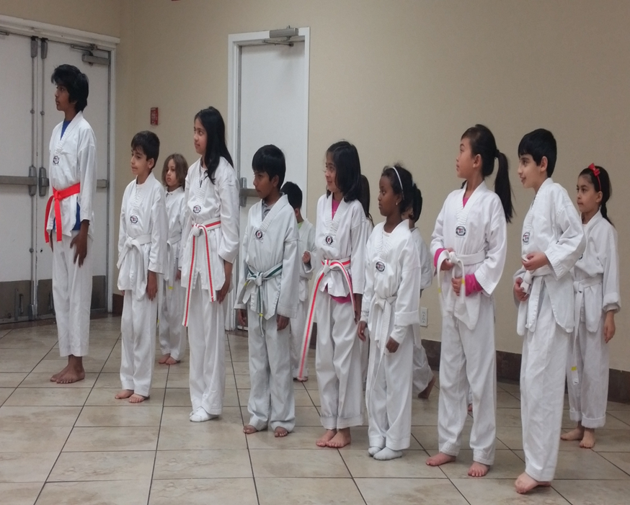
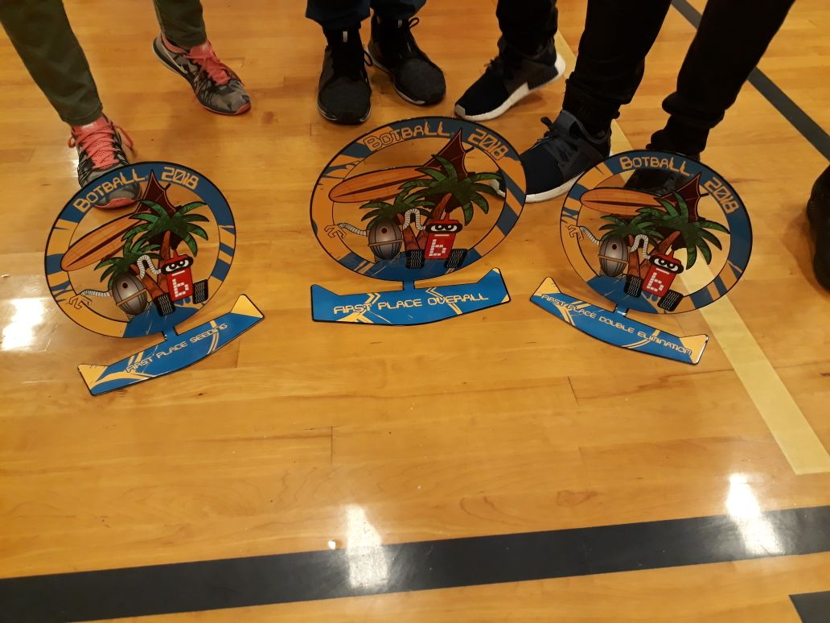
STEM at ISSD today
Alhamdulillah, ISSD has one of the top middle school STEM (Science, Technology, Engineering, and Math) programs in San Diego
Arthur Friedman Teacher of the Year awarded to ISSD Staff two years in a row
ISSD Staff one of the three top finalists for Teacher of the Year in California State-Wide
Robotics Program in top 10% of all state-wide programs and quickly approaching top 5%
Multiple Champions Awards at Regional and Finals Tournaments
Over 50% of 7th and 8th grade students received 1st place in San Diego Science Fair with a third advancing to State Science Fair
One project awarded overall Sweepstakes winner
One project recognized as top 10 extraordinary projects state wide receiving a large cash prize
Many special society awards
First Place Winner (6th grade) in Interschool Southern California Spelling Bee

Slide 14
Q & A

Slide 15
Our Vision…
… be “the” best Islamic School in US, #1
We have the will, finances and resources to make it happen, in’sha’Allah !
How exactly?!
1. Financial stability
2. Great facility
3. Best administration
4. Best teachers and curriculum
5. Best student body

Slide 16
Backup / More Details

Slide 17
Staffing: Teachers and Admin
Concluded
On-going
Overall school Principal
Director of Education with initial focus on HS program
Secured HS English (and potentially elective) teacher
Professional Financial services company
Admin
Credentialed Math, Science teachers
PE teacher
KG teacher (identified)
Security personal
Driver
All by end of August

Slide 18
Academics
Concluded
On-going
Course lineup
English, Math, Science, PE
AP classes – starting 10th grade as public schools
Course lineup
Elective, honor in 9th grade
Choice of text books
June-July timeframe
Course description & units details – end of August
WASC Accreditation
WASC visit/assessment in Nov.’18
Clearing this clears UCSD/SDSU Accreditation
Securing TK and/or KG (parallel to ISSD) – end of June

Slide 19
ISSD Student Life
Alhamdulillah, ISSD offers a rich set of Extra-Curricular Activities for its students
Botball
Dawah Club
Essay Contest
Quran Contest
Robotics Program
Science Fair
Spelling Bee
Student Council
Tae Kwon Do
Umrah Program
Yearbook club
Young Coders Club
Youth Soccer

Slide 20
ISSD Robotics - Botball
Botball San Diego Regionals
1st place overall
Engineering, Programming, Documentation, and Oral Presentation
1st place double elimination
Undefeated in tournament competition
1st place seeding
Highest scoring in seeding rounds
Invited to International Tournament in July

